Slide 1

Basic Details of the Team and Problem Statement
Ministry/Organization Name/Student Innovation:
North Eastern Cane and Bamboo Development Council
(NECBDC).
PS Code: MG1100
Problem Statement Title: Development of Dynamic website of NECBDC
Team Name: Team PoGo
Team Leader Name: Shubham Rastogi
Institute Code (AISHE): U-1056
Institute Name: Netaji Subhas University of Technology.
Theme Name: Smart Automation

Slide 2
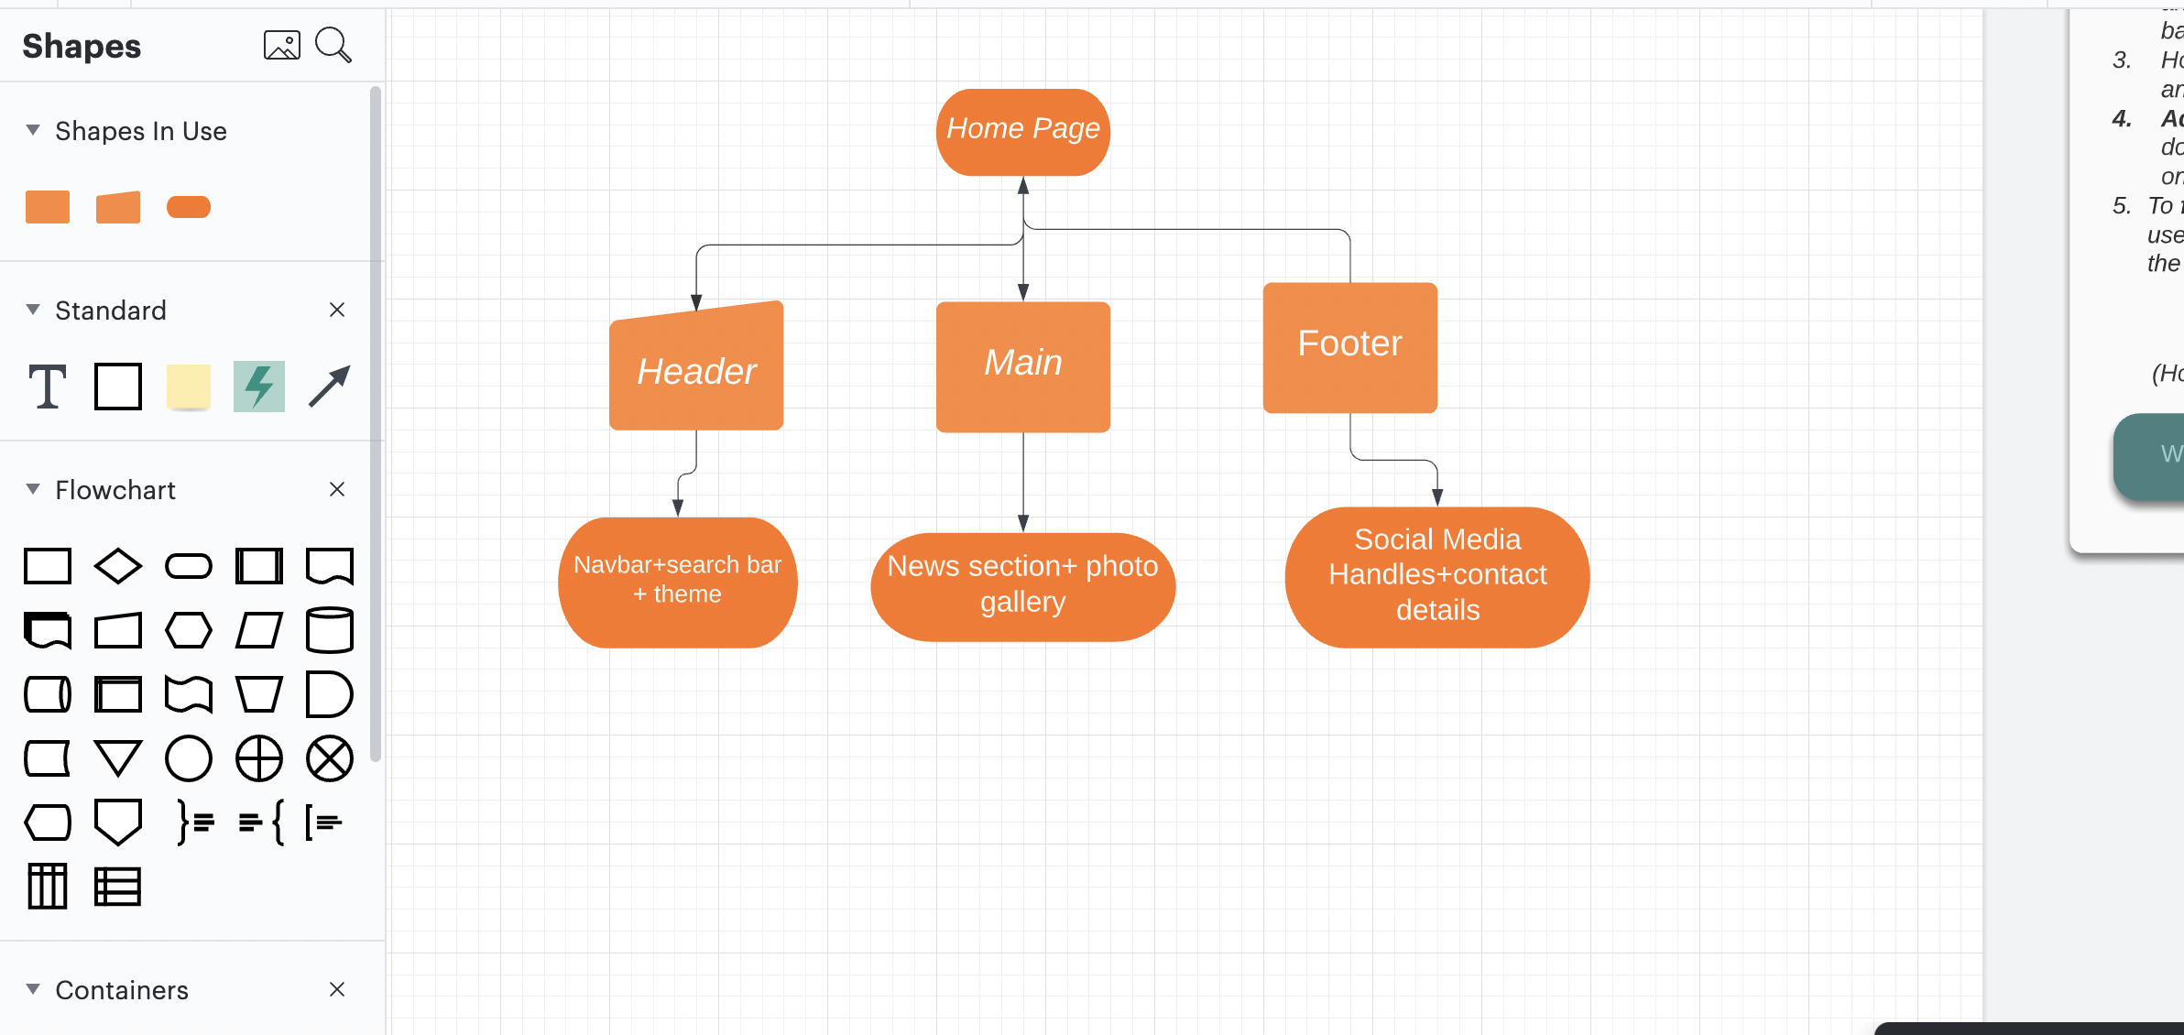
Idea/Approach Details
Describe your idea/Solution/Prototype here:
We will make this site (www.necbdc.org.in) responsive using media queries so that the site is optimized/compatible to work on multiple devices.
We will add social media handles in the website so that user can contact to the admin with ease.
We will improve the UI/UX of the site to enhance the user experience .
We will work upon redesigning of hamburger menu.
Proper resizing of images.
We will make navbar sticky and align the search bar along with it.
We will add sitemap in the website so that user can navigate through our site easily.
Describe your Technology stack here:
Frontend : HTML, CSS, Javascript, ReactJS, XML.
Hosting : Heroku, netlify.

Slide 3
Idea/Approach Details
Describe your Use Cases here
Describe your Dependencies / Show stopper here
Allows organizations to upload pictures of their own, which resonates with them even more and thus adding to the ease of memorization.
News articles and regular updates.
User experience will enhance.
Decent internet connection, the images will take time to load .
The organization should update content on a regular basis.
Proper hosting service.

Slide 4
Team Member Details
Team Leader Name: Shubham Rastogi
Branch (Btech/Mtech/PhD etc): BTech Stream (ECE, CSE etc): ECE Year (I,II,III,IV): ll
Team Member 1 Name: Shutikshan Madhur
Branch (Btech/Mtech/PhD etc): BTech Stream (ECE, CSE etc): ECE Year (I,II,III,IV): ll
Team Member 2 Name: Priyanshu Singh
Branch (Btech/Mtech/PhD etc): BTech Stream (ECE, CSE etc): Mechanical engg Year (I,II,III,IV): ll
Team Member 3 Name: Shubham Pal
Branch (Btech/Mtech/PhD etc): BTech Stream (ECE, CSE etc): ECE Year (I,II,III,IV): ll
Team Member 4 Name: Himani Dahiya
Branch (Btech/Mtech/PhD etc): BTech. Stream (ECE, CSE etc): ECE Year (I,II,III,IV): ll
Team Member 5 Name: Yash Gupta
Branch (Btech/Mtech/PhD etc): BTech. Stream (ECE, CSE etc): ECE Year (I,II,III,IV): ll

